Slide 1
Unit-1
Computer Evolution , Performance Measurement & Arithmetic
1

Slide 2
Syllabus (8Hours)
A Brief History of Computers, Von Neumann Architecture, Harvard Architecture.
Computer Performance Measurement – Benchmarks (SPEC) for Evaluation, Metrics such as CPU Time,
Throughput, etc., Aspects & Factors affecting Computer Performance, Comparing Computer
Performances, Marketing Metrics – MIPS & MFLOPS, Speedup & Amdahl’s Law
Booths Algorithm For Signed Multiplication & it’s Hardware Implementation, Restoring And Non
Restoring Division Algorithms & it’s Hardware Implementation

Slide 3
Architecture & Organization
Architecture is those attributes visible to the programmer
Instruction set, number of bits used for data representation, I/O mechanisms, addressing techniques.
e.g. Is there a multiply instruction?
Organization is how features are implemented
Control signals, interfaces, memory technology.
e.g. Is there a hardware multiply unit or is it done by repeated addition?

Slide 4
Architecture & Organization (cont..)
All Intel x86 family share the same basic architecture
The IBM System/370 family share the same basic architecture
This gives code compatibility
At least backwards
Organization differs between different versions

Slide 5
Brief History of Computers
1^{st Generation: Vacuum Tubes}
^{2nd Generation: Transistors}
3rd Generation: Integrated Circuits
Later Generations: LSI,VLSI,ULSI

Slide 6
Generations of Computer
Vacuum tube - 1946-1957 - 40,000 op/s
Transistor - 1958-1964- 200,000 op/s
Small scale integration - 1965 on
Up to 100 devices on a chip ; 1,000,000 op/s
Medium scale integration - to 1971
100-3,000 devices on a chip; 1,000,000 op/s
Large scale integration - 1971-1977
3,000 - 100,000 devices on a chip; 10,000,000 op/s
Very large scale integration - 1978 to date
100,000 - 100,000,000 devices on a chip; 100,000,000 op/s
Ultra large scale integration
Over 100,000,000 devices on a chip; 1000,000,000 op/s

Slide 7
von Neumann Architecture
It is based on three key concepts:
Data and instructions are stored in a single read–write memory.
The contents of this memory are addressable by location, without regard to the type of data contained there.
Execution occurs in a sequential fashion (unless explicitly modified) from one instruction to the next.
Example : 80x86 architecture

Slide 8
von Neumann Architecture (cont..)
Processor needs two clock cycles to complete an instruction.
In the first clock cycle the processor gets the instruction from memory and decodes it.
In the next clock cycle the required data is taken from memory.
For each instruction this cycle repeats and hence needs two cycles to complete an instruction.
Pipelining the instructions is not possible with this architecture.
This is a relatively older architecture and was replaced by Harvard architecture.

Slide 9
von Neumann/Turing
Stored Program concept
Main memory storing programs and data
ALU operating on binary data
Control unit interpreting instructions from memory and executing
Input and output equipment operated by control unit
Princeton Institute for Advanced Studies
IAS
Completed 1952

Slide 10
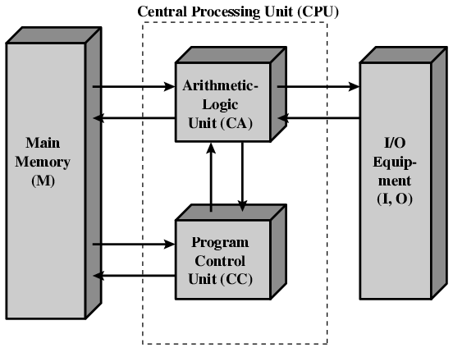
Structure of von Neumann machine

Slide 11
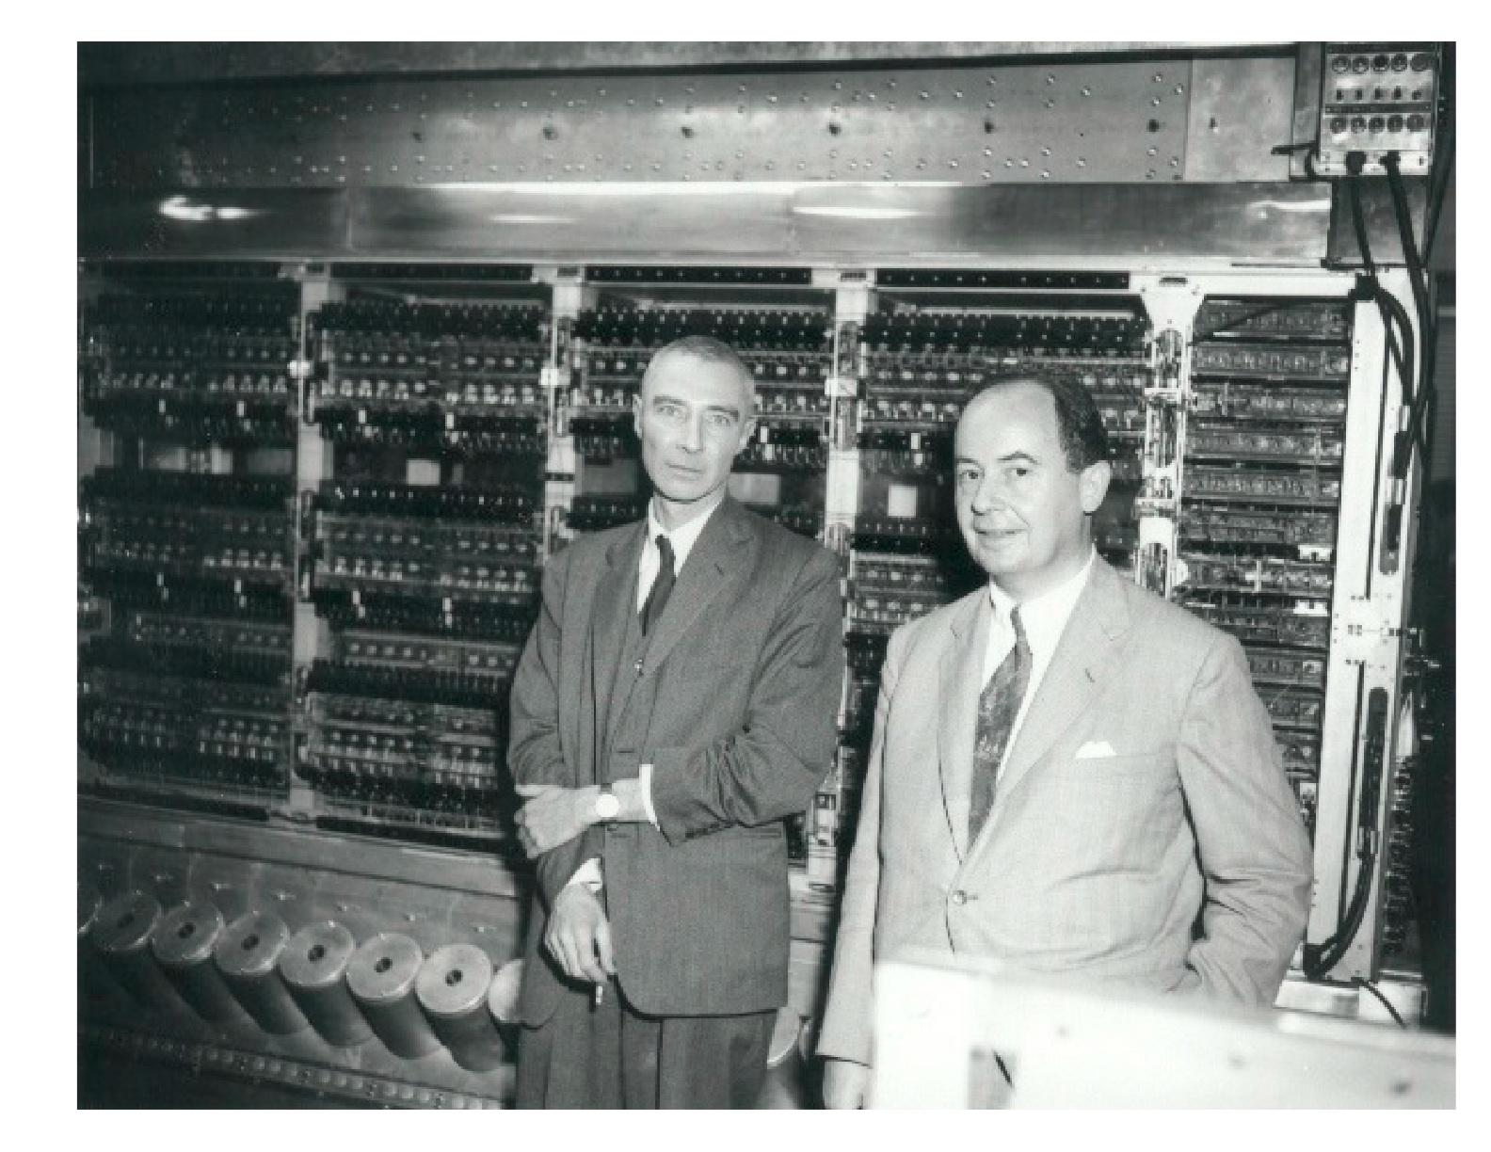
von Neumann/Turing

Slide 12
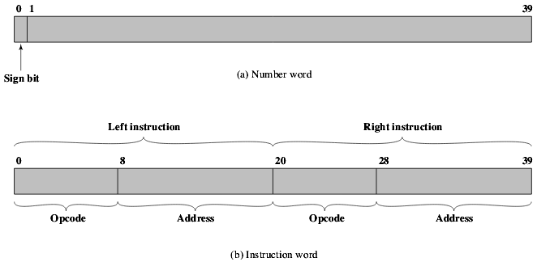
IAS - details
Storage locations
For both data and instructions
1000 x 40 bit words
Storage in the form of Binary number
2 x 20 bit instructions
IAS Memory Formats

Slide 13
IAS – details (cont..)
Set of registers (storage in CPU)
Memory Buffer Register(MBR)
Memory Address Register(MAR)
Instruction Register(IR)
Instruction Buffer Register(IBR)
Program Counter(PC)
Accumulator(AC)
Multiplier Quotient(MQ)

Slide 14
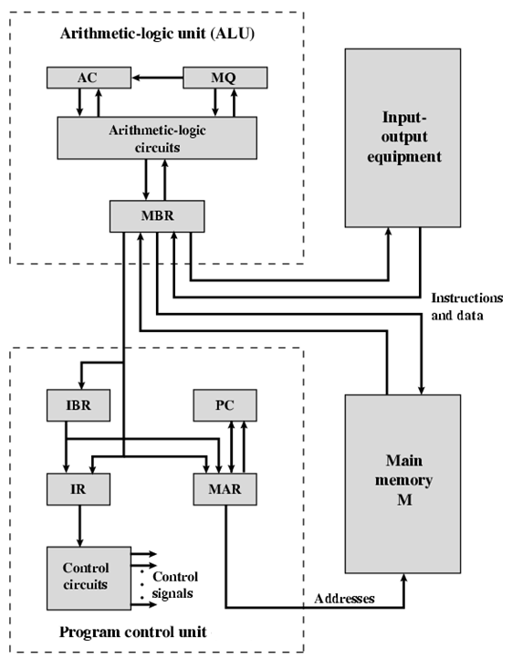
Structure of IAS – detail

Slide 15
IAS registers
Memory buffer register (MBR):
Contains a word to be stored in memory or sent to the I/O unit, or is used to receive a word from memory or from the I/O unit.
Memory address register (MAR):
Specifies the address in memory of the word to be written from or read into the MBR.
Instruction register (IR):
Contains the 8-bit opcode instruction being executed.
Instruction buffer register (IBR):
Employed to hold temporarily the right-hand instruction from a word in memory.

Slide 16
IAS registers (cont..)
Program counter (PC):
Contains the address of the next instruction-pair to be fetched from memory.
Accumulator (AC) and multiplier quotient (MQ):
Employed to hold temporarily operands and results of ALU operations. For example, the result of multiplying two 40-bit numbers is an 80-bit number; the most significant 40 bits are stored in the AC and the least significant in the MQ.

Slide 17
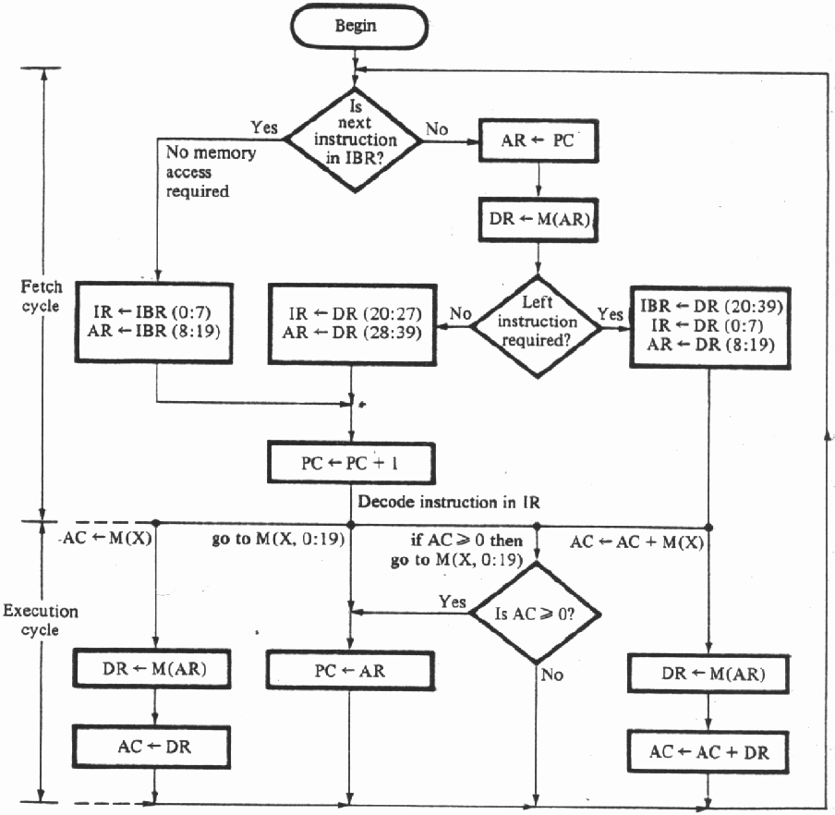
Partial Flow Chart of IAS opera-tions

Slide 18
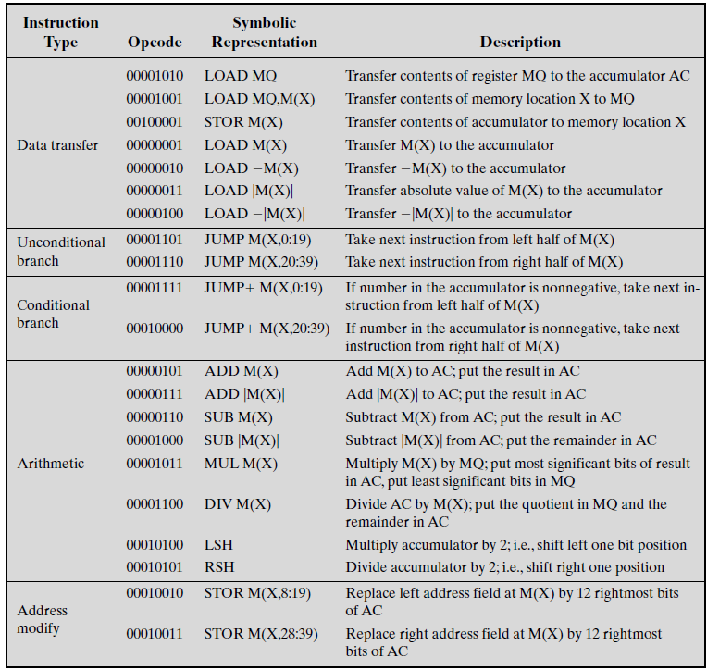
IAS Instru-ction Set

Slide 19
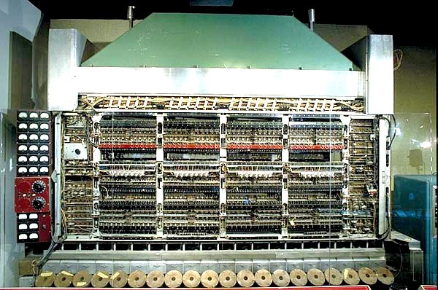
IAS

Slide 20
Harvard Architecture
Physically separate memory and signal pathways into 2 types
Program memory (Instructions)
Data memory
Used in MCS-51, MIPS etc.

Slide 21
Harvard Architecture (cont..)
No need to make the two memories share characteristics.
In particular, the word width, timing, implementation technology, and memory address structure can differ.
In some systems, instructions can be stored in read-only memory while data memory generally requires read-write memory.
Instruction memory is often wider than data memory.
Notes:
CS402 Notes --- 2007-8
Copyright University of Strathclyde 2007

Slide 22
Harvard Architecture (cont..)
Processor can complete an instruction in one cycle if appropriate pipelining strategies are implemented.
In the first stage of pipeline the instruction to be executed can be taken from program memory.
In the second stage of pipeline data is taken from the data memory using the decoded instruction or address.
Most of the modern computing architectures are based on Harvard architecture. But the number of stages in the pipeline varies from system to system.

Slide 23
Harvard Architecture (cont..)

Slide 24
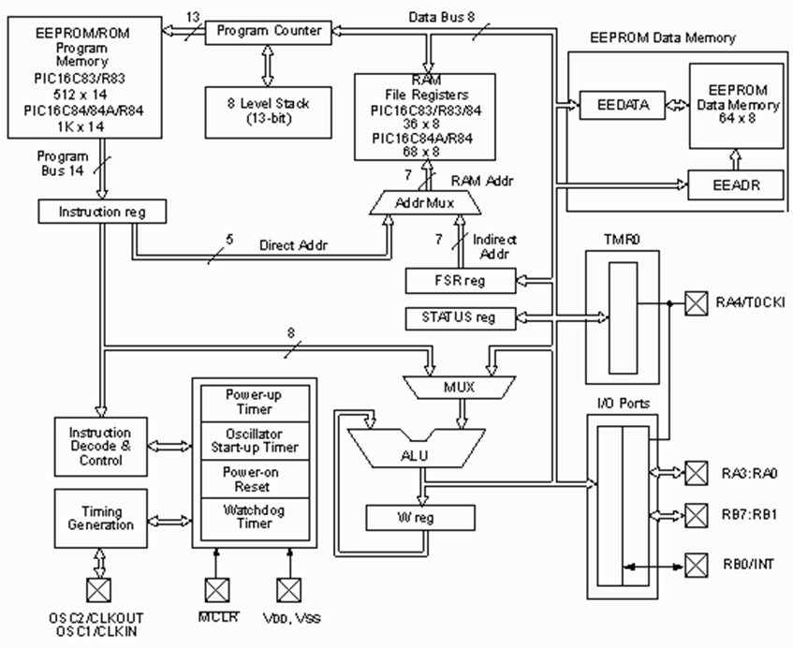
Harvard Archite-cture Example PIC16C8X

Slide 25
Von Neumann Vs Harvard Architecture
In a computer with a von Neumann architecture (and no cache), the CPU can be either reading an instruction or reading/writing data from/to the memory.
Both cannot occur at the same time since the instructions and data use the same bus system.
In a computer using the Harvard architecture, the CPU can read both an instruction and perform a data memory access at the same time, even without a cache.
A Harvard architecture computer can thus be faster for a given circuit complexity because instruction fetches and data access do not contend for a single memory pathway.
Notes:
CS402 Notes --- 2007-8
Copyright University of Strathclyde 2007

Slide 26
Designing for Performance
Microprocessor speed
Branch prediction
Data flow analysis
Speculative execution
Performance balance
throughput and processing demands of the processor components, main memory, I/O devices, and the interconnection structures
caching and buffering schemes
the use of higher-speed interconnection buses and more elaborate structures of buses
the use of multiple-processor configurations can aid in satisfying I/O demands

Slide 27
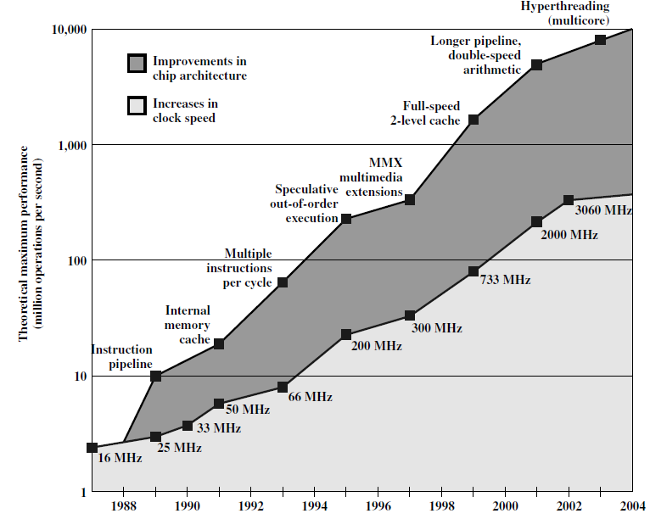
Designing for Performance(cont..)
Improvement in chip organization & architecture
Intel Micro-
processor
performance

Slide 28
Computer Performance Measurement
Key parameters
Performance, cost, size, security, reliability, power consumption
Clock Speed
Instruction Execution Rate
System clock speed:
Clock signals are generated by a quartz crystal, which generates a constant signal wave while power is applied.
This wave is converted into a digital voltage pulse stream that is provided in a constant flow to the processor circuitry. e.g. a 1-GHz processor receives 1 billion pulses per second.

Slide 29
System clock speed (cont..)
The rate of pulses is known as the clock rate, or clock speed.
One increment, or pulse, of the clock is referred to as a clock cycle, or a clock tick.
The time between pulses is the cycle time.

Slide 30
System clock speed (cont..)
Signals in CPU take time to settle down to 1 or 0
Signals may change at different speeds
Operations need to be synchronised
Instruction execution in discrete steps
Fetch, decode, load and store, arithmetic or logical
Usually require multiple clock cycles per instruction
Pipelining gives simultaneous execution of instructions

Slide 31
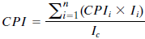
Instruction Execution Rate
Let CPIi be the number of cycles required for instruction type i ; Ii be the number of executed instructions of type i for a given program and Ic be the Instruction count of that program then average Cycles per Instruction(CPI) is given by:
The processor time T needed to execute a given program can be expressed as:

Slide 32
Factors affecting Computer Performance
p is the number of processor cycles needed to decode and execute the instruction,
m is the number of memory references needed,
k is the ratio between memory cycle time and processor cycle time
a constant cycle time

Slide 33
Instruction Execution Rate
Millions of instructions per second (MIPS)
Millions of floating point instructions per second (MFLOPS)
Heavily dependent on instruction set, compiler design, processor implementation, cache & memory hierarchy

Slide 34
Need for benchmarks:
Measures such as MIPS and MFLOPS have proven inadequate to evaluating the performance of processors.
Because of differences in instruction sets, the instruction execution rate is not a valid means of comparing the performance of different architectures.

Slide 35
Benchmarks
Programs designed to test performance
Written in high level language
Portable
Represents style of task
Systems, numerical, commercial
Easily measured
Widely distributed
E.g. System Performance Evaluation Corporation (SPEC)
CPU2006 for computation bound
17 floating point programs in C, C++, Fortran
12 integer programs in C, C++
3 million lines of code
Speed and rate metrics
Single task and throughput

Slide 36
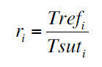
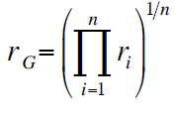
SPEC Speed Metric
Single task
Base runtime defined for each benchmark using reference machine
Results are reported as ratio of reference time to system run time
Trefi execution time for benchmark i on reference machine
Tsuti execution time of benchmark i on test system
Overall performance calculated by averaging ratios for all 12 integer benchmarks
Use geometric mean
Appropriate for normalized numbers such as ratios

Slide 37
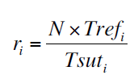
SPEC Rate Metric
Measures throughput or rate of a machine carrying out a number of tasks
Multiple copies of benchmarks run simultaneously
Typically, same as number of processors
Ratio is calculated as follows:
Trefi reference execution time for benchmark i
N number of copies run simultaneously
Tsuti elapsed time from start of execution of program on all N processors until completion of all copies of program
Again, a geometric mean is calculated

Slide 38
Amdahl’s Law
Potential speed up of program using multiple processors
Concluded that:
Code needs to be parallelizable
Speed up is bound, giving diminishing returns for more processors
Task dependent
Servers gain by maintaining multiple connections on multiple processors
Databases can be split into parallel tasks
[Ref.- Amdahl, G. “Validity of the Single-Processor Approach to Achieving Large-Scale Computing Capability”, Proceedings of the AFIPS Conference, 1967.]

Slide 39
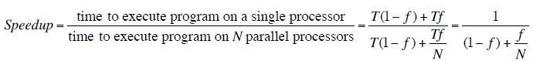
Amdahl’s Law Formula
For program running on single processor
Fraction f of code infinitely parallelizable with no scheduling overhead
Fraction (1-f) of code inherently serial
T is total execution time for program on single processor
N is number of processors that fully exploit parralle portions of code
Conclusions
f small, parallel processors has little effect
N ->∞, speedup bound by 1/(1 – f)
Diminishing returns for using more processors

Slide 40
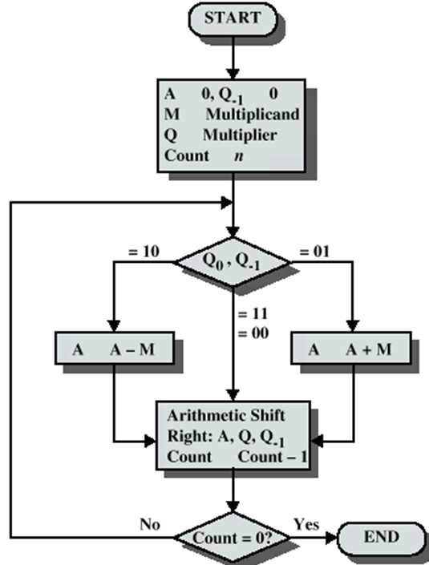
Booth’s Algorithm

Slide 41
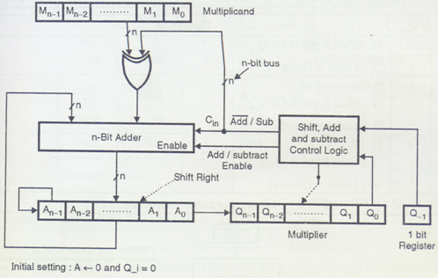
Hardware Implementation of Booth’s Algorithm

Slide 42
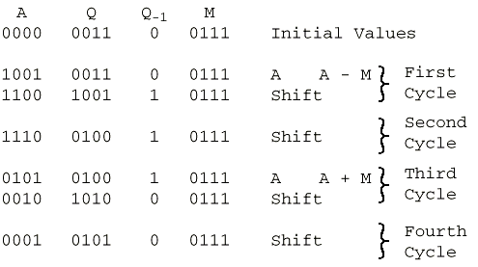
Example of Booth’s Algorithm

Slide 43
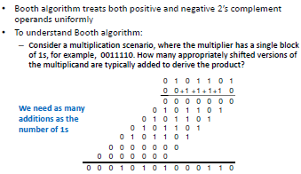
Booth’s Algorithm(cont..)

Slide 44
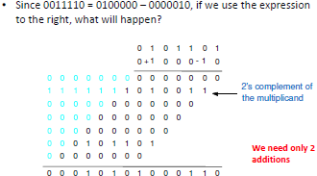
Booth’s Algorithm(cont..)
The transformation 011... 110 =>• +100... .0 -10 is called
skipping over 1s. It is derived from the case in which the
multiplier has its 1s grouped into a few contiguous blocks.

Slide 45
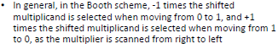
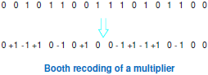
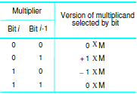
Booth Multiplier Recoding Scheme
+1 x M = M
-1 x M = 2’s complement of M

Slide 46
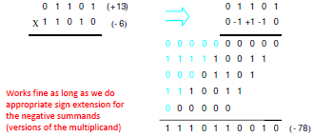
Example of Booth’s Algorithm with Negative Multiplier

Slide 47
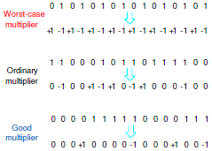
Efficiency of Booth’s Algorithm

Slide 48
Features of Booth’s Algorithm
It handles both positive and negative multipliers uniformly.
It achieves some efficiency in the number of additions required when the multiplier has a few large blocks of 1 s. The speed gained by skipping over 1s depends on the data.
On average, the speed of doing multiplication with the Booth algorithm is the same as with the normal algorithm.

Slide 49
Fast Multiplication
There are two techniques for speeding up the multiplication operation:
Bit-Pair Recoding of Multipliers:
It guarantees that the maximum number of summands (versions of the multiplicand) that must be added is n/2 for n-bit operands.
Carry-save addition of summands :
It reduces the time needed to add the summands.

Slide 50
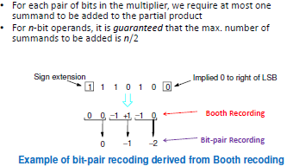
Bit-Pair Recoding of Multipliers

Slide 51
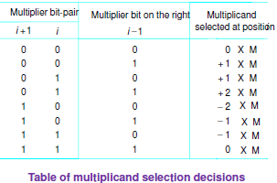
Bit-Pair Recoding of Multipliers(cont..)

Slide 52
Booth’s 1-bit & 2- bits (Bit-Pair) Recoding of Multipliers
Multiplier Bits | Booth’s recoding (1-bit) | Bit-pair Recoding (2-bit)
i+1 | i | i-1
0 | 0 | 0 | ( 0 0) | 0
0 | 0 | 1 | ( 0 +1) | 1
0 | 1 | 0 | (+1 -1) | 1
0 | 1 | 1 | (+1 0) | +2
1 | 0 | 0 | (-1 0) | -2
1 | 0 | 1 | (-1 +1) | -1
1 | 1 | 0 | ( 0 -1) | -1
1 | 1 | 1 | ( 0 0) | 0

Slide 53
Booth’s 1-bit & 2- bits (Bit-Pair) Recoding of Multipliers (cont..)
For 2-bit Booth’s recoding, look at each pair of bits:
Remember that the leftmost bit has 2X the weight of the rightmost bit in each pair. So the pair (1 -1) means 2*1 + -1 = 1
Thus in the 2-bit recoding, you could have 3 and -3, but these would have to result from the pairs (1 1) and (-1 -1) arising in the 1-bit encoding. But neither of these pairs can happen because a -1 indicates the start of a string of ones (the rightmost end) and a 1 indicates the end of a string of ones. You can't have two adjacent starts or ends because at least one of the pair would have to be part of a longer string of ones.
It can be also calculated directly by considering triplets (i+1, i, i-1) in the multiplier.

Slide 54
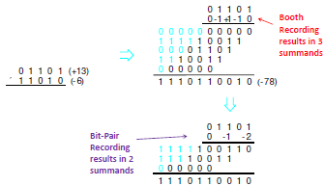
Example of Bit-Pair Recoding of Multipliers
+2 x M = 0..0010 x M+ = 0..0M0
-2 x M = 2’s complement of (+2xM= 0..0M0) OR +2 x(2’s complement of M)

Slide 55
Division
More complex than multiplication
Negative numbers are really bad!
Based on long division

Slide 56
Division of Unsigned Binary Integers
00001101
Quotient
Divisor
1011
10010011
Dividend
1011
001110
Partial
Remainders
1011
001111
1011
Remainder
100

Slide 57
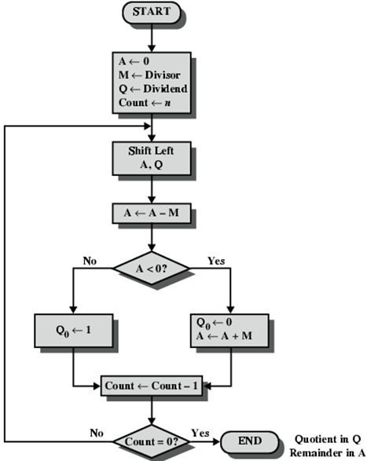
Flowchart for Unsigned Binary Division (Restoring)

Slide 58
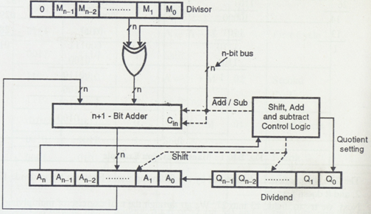
Hardware Implementation of Restoring Division Algorithm

Slide 59
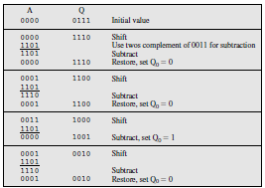
Restoring division example 7/3
Q= (Q) as signs of divisor & dividend are same.
R=A
7/3 →
D = 7, V = 3 → Q = 2, R = 1

Slide 60
Signed Division
1. Load divisor into M and the dividend into A,Q registers. Dividend must be 2n-bit 2’s complement number.
e.g. 0111 (7) becomes 00000111 &
1001 (-7) becomes 11111001
2. Shift A,Q left 1 bit position
3. If M and A have the same signs, A←A –M
else A←A+M

Slide 61
Signed Division(cont..)
4. Step 3 is successful if sign of A is the same as before step 3 and at the end of step 3
if successful or (A=0 AND Q=0) then set Q_{0←1}
if unsuccessful and (A ≠ 0 OR Q≠0) then restore the previous value of A
5. Repeat steps 2 through 4 as many times as there are bit positions in Q.
_{6. The remainder is in A.}

Slide 62
Signed Division(cont..)
If the signs of Divisor and dividend were the same, the quotient is in Q, otherwise the correct quotient is obtained by taking twos complement of the quotient in Q.
The remainder is defined by
Dividend(D)=Quotient(Q)xDivisor(V)+Remainder(R)
sign(R) = sign(D)
sign(Q) = sign(D) * sign(V).
e.g.: a) 7/3 → D = 7, V = 3 → Q = 2, R = 1
b) 7/(-3) → D = 7, V = -3 → Q = -2, R = 1
c) (-7)/3 → D = -7, V = 3 → Q = -2, R = -1
d) (-7)/(-3) → D = -7, V = -3 → Q = 2, R = -1

Slide 63
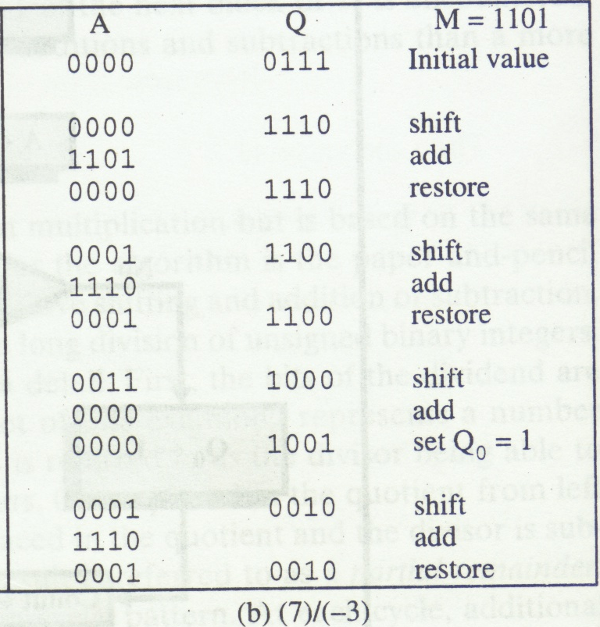
Restoring division example 7/ (-3)
Q=2’s comple(Q) as signs of divisor & dividend are different.
R=A
7/(-3) →
D = 7, V = 3 →
Q = - 2, R = 1

Slide 64
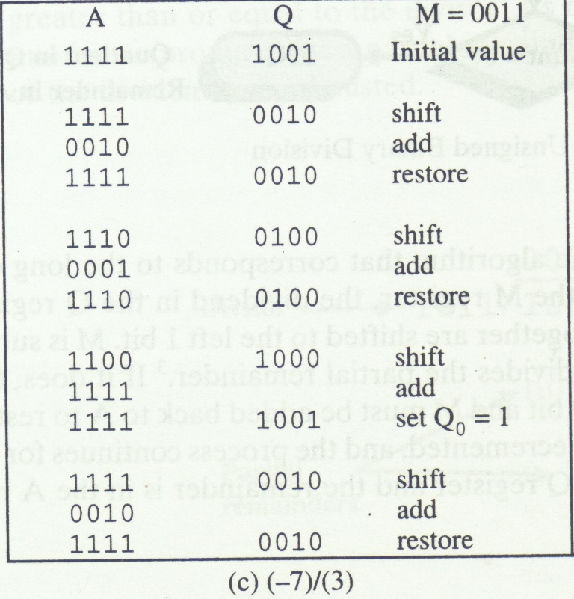
Restoring division example -7/3
Q=2’s comple(Q) as signs of divisor & dividend are different.
R=A
(-7)/3 →
D = -7, V = 3 → Q = -2, R = -1

Slide 65
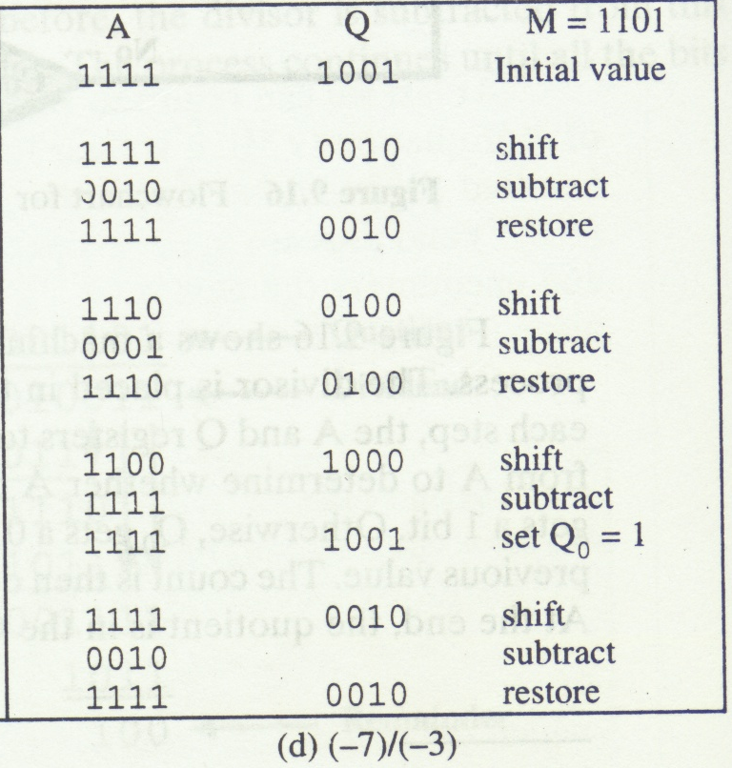
Restoring division example (-7)/ (-3)
Q= (Q) as signs of divisor & dividend are same.
R=A
(-7)/(-3) →
D = -7, V = -3 →
Q = 2, R = -1

Slide 66
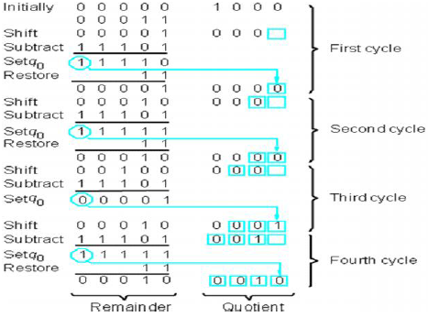
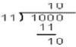
Restoring Division Example (8/3)

Slide 67
Non-Restoring Division
The restoring-division algorithm can be improved by avoiding the need for restoring A after an unsuccessful subtraction.
Subtraction is said to be unsuccessful if the result is negative.
Algorithm:
Step 1: Do the following n times:
If the sign of A is 0, shift A and Q left one bit position and subtract M from A; otherwise, shift A and Q left and add M to A.
Now, if the sign of A is 0, set q0 to 1; otherwise, set q0 to 0.
Step 2: If the sign of A is 1, add M to A.
Step 2 is needed to leave the proper positive remainder in A at
the end of the n cycles of Step 1.

Slide 68
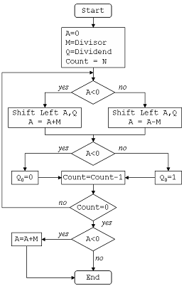
Flowchart of Non-Restoring Division

Slide 69
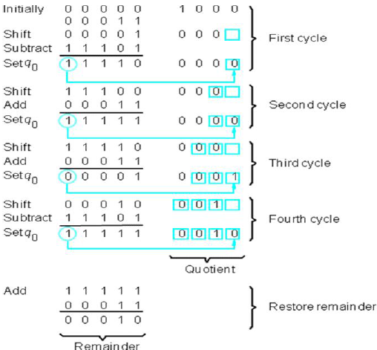
Example of Non-Restoring Division

